Slide 1

Final Project Presentation For Machine Learning
Ang wee hwa 27/4/2021
DS105

Slide 2


Crypto-currency
Ang wee hwa 27/4/2021
Crypto Currency is a digital asset
Designed to work as an exchange wherein individual coin ownership are stored in a ledger existing in a form of a computer database
Substitute existing physical money and act as a stable coin of exchange for purchases
Save time as transfer is almost instant and cheaper
Example : Bitcoins can buy Telsa Cars, BullionStar (Singapore) to buy Gold bar etc.

Slide 3

Why Bitcoin?
Ang wee hwa 27/4/2021
Crypto Currency had been on a raise of more than 1000 percent in recent months outperforming most of the exchanges with a growing interest in consumers.
Bitcoin is the first ever crypto currency created
It is a more stable coin as compared to other crypto currency and people have trust in the token as many big establishment and banks had them in as their reserve assists (ie: DBS Digital Currency Exchange)
With the preparation of lunching digital banks in Singapore there will be a even more growing interest in digital assets.

Slide 4

Problem Statement
Ang wee hwa 27/4/2021
To predict the future price increase or decrease percentage of bitcoins
Sub Questions:
What is the correlation ship of the coins
When is the best time to purchase bitcoins?

Slide 5

Difficulties
Ang wee hwa 27/4/2021
Data is live hence figures is ever-changing hence model may not be able to capture certain trends.
Price is affected by many other factors including news, partnerships or profit taking over certain period which cause spike and dip in prices hence machine might not be able include them as features to consider when doing the learning.

Slide 6

Steps
Ang wee hwa 27/4/2021
Will extract the data from yfinance a library in python which takes real life data from the website: Yahoo Finance
Will break into 3 parts for this project
Part A : Extract, clean and trim dataset to closing difference percentage
Part B: Explore the dataset and do some visualisation
Part C : Use 4 machine learning models for regression namely (1) Linear Regression, (2) Support Vector Regression, (3) XGBoost - ensemble of Decision Tree and boosting models and (4) Random Forest - Ensemble of Decision tree and bagging model; and to find the best performance model and do hyper perimeter tuning.

Slide 7
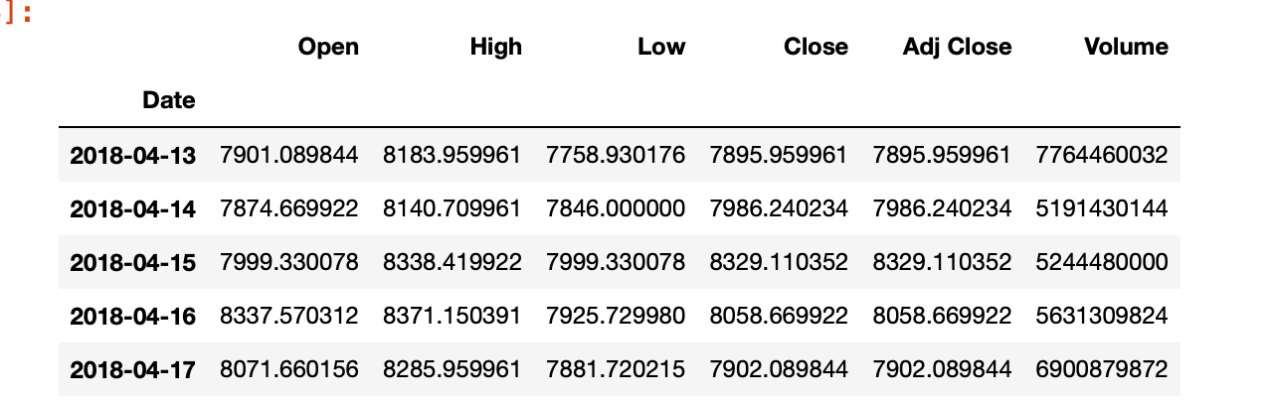
Dataset
Ang wee hwa 27/4/2021
Data is from python library: yfinance
5 Min trading data for 60 days
Will use 18 Coins and create a column for past hour trading outcome for Bitcoins as a new feature for the training and observation
Dataset includes
1) Open Price of the day
2) Highest price of the day
3) Lowest Price of the day
4) Close Price fort the day
5) Adj Close Price for the day (after adjustments for all applicable splits and dividend distributions)
6) Volume

Slide 8
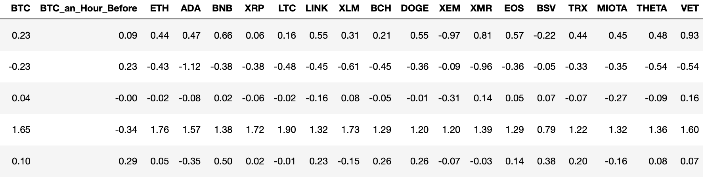
Part A : Data cleaning
Ang wee hwa 27/4/2021
We will be extracting 18 coins prices hence will unify the columns by creating a new column (diff) by taking the closing price deduct by opening price divide by the opening price multiply by 100 to have the percentage gain or loss on the day.
Next we will merge all dataset together
With the new dataset we will check for null value and drop data with missing values as all coins are traded in a specific time hence to have some missing values as features will not be feasible.
Label

Slide 9
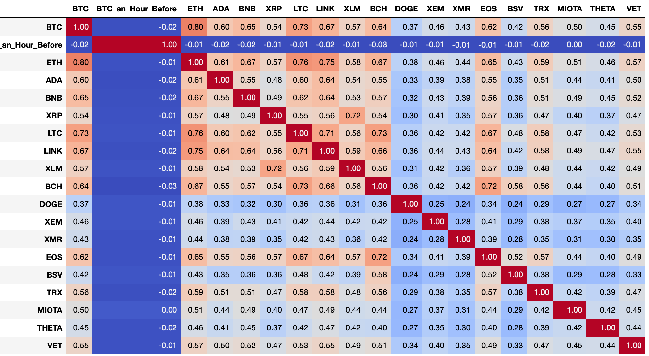
Part B : Analysis
Ang wee hwa 27/4/2021
1) What is the correlation-ship between the coins?
- Plot it using cold warm map

Slide 10
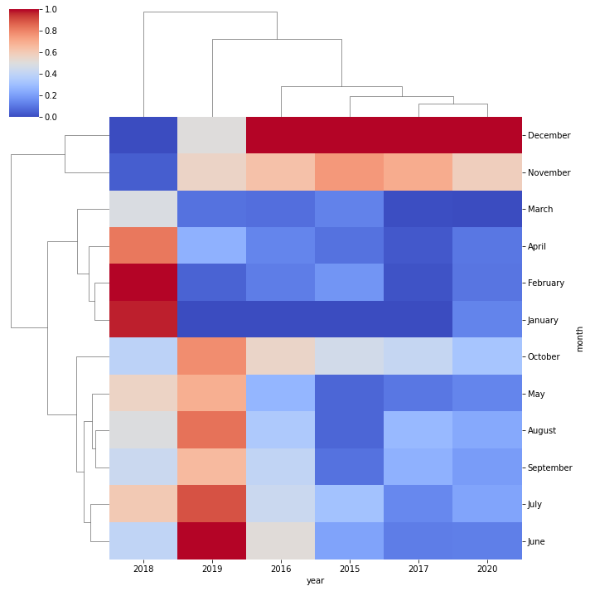


Part B : Analysis
Ang wee hwa 27/4/2021
2) When is the best time to purchase Bitcoins?
- Extract bitcoin prices
- Use the date time to split the month and year
- Best to make purchase first half of the year and sell second half of the year

Slide 11

Part C : Machine Learning Model
Ang wee hwa 27/4/2021
For this problem statement I will be using supervise learning regression models as we are predicting the future price changes percentage. Will use standard scaler to scale the datas.
Linear Regression
Support Vector Regression
XGBoost
Random Forest
After comparing the performance of the 4 models will select the one with the best prediction to do hyper parameter tuning.

Slide 12
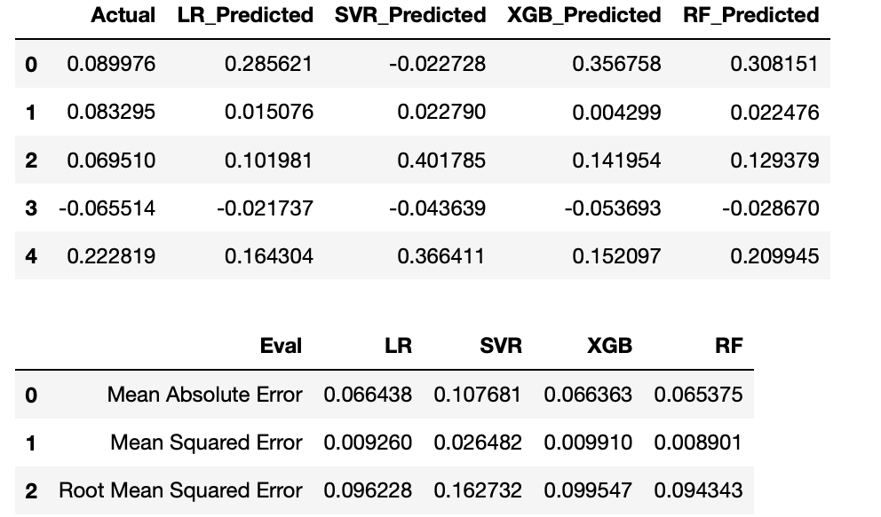
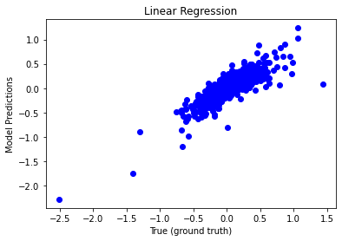
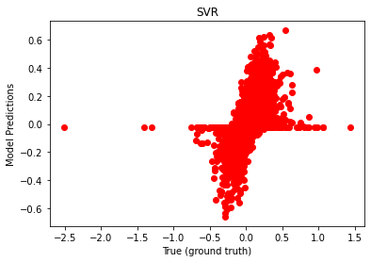
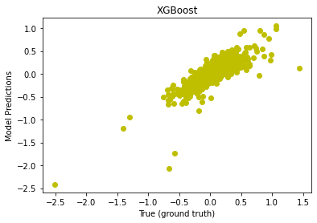
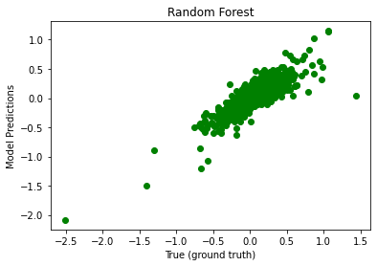
Result
Ang wee hwa 27/4/2021
Measurements:
1) Mean Absolute Error
2) Mean Squared Error
3) Root Mean Squared Error
Constant measurement so we find the difference

Slide 13
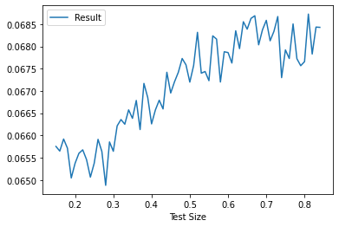
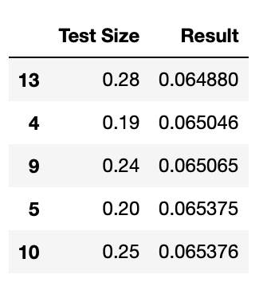
Hyper Parimeter Tuning - Test Size
Ang wee hwa 27/4/2021
- We will test the test size of the best model (Random Forest) from 0.1 to 0.9 and observe to select the best test size and use mean absolute error to test the range of test size
- From this observation we can see that with 0.28 test size ut achieve a lower Mean Absolute Error

Slide 14
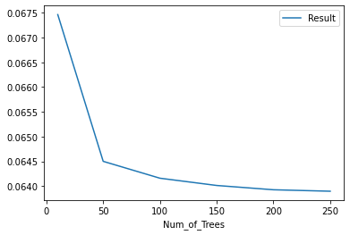
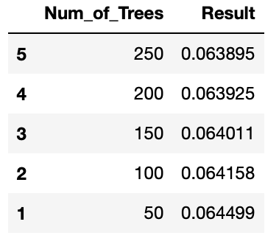
Hyper Parimeter Tuning - n_estimator
Ang wee hwa 27/4/2021
- We will test the number of estimator (num of trees) between the list of 10,50,150,200 and 250 with the result previously for best test size and find the best num of estimator
- From observation the more estimator we use the better the result = lower mean absolute error
- However with more estimator the performance fo the model will be slower hence with that in mind we observe that after the 150 estimator the improvement of the model is lesser hence we will use 150 for our best model

Slide 15
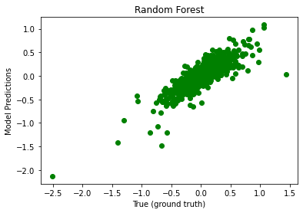
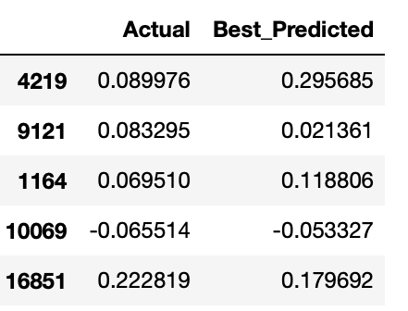
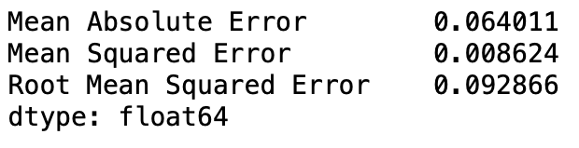
Best Model and result
Ang wee hwa 27/4/2021
After the testing and hyper perimeter tuning we have selected the model as below and specs for the best predictive model:
1) Random Forest
2) Test Size : 0.28
3) n_estimator : 150
From observation we can see the n the improvement of the 3 measurements as compared to our prediction previously

Slide 16

“Blockchain is the tech. Bitcoin is merely the first mainstream manifestation of its potential.”
Marc Kenigsberg

